Slide 1
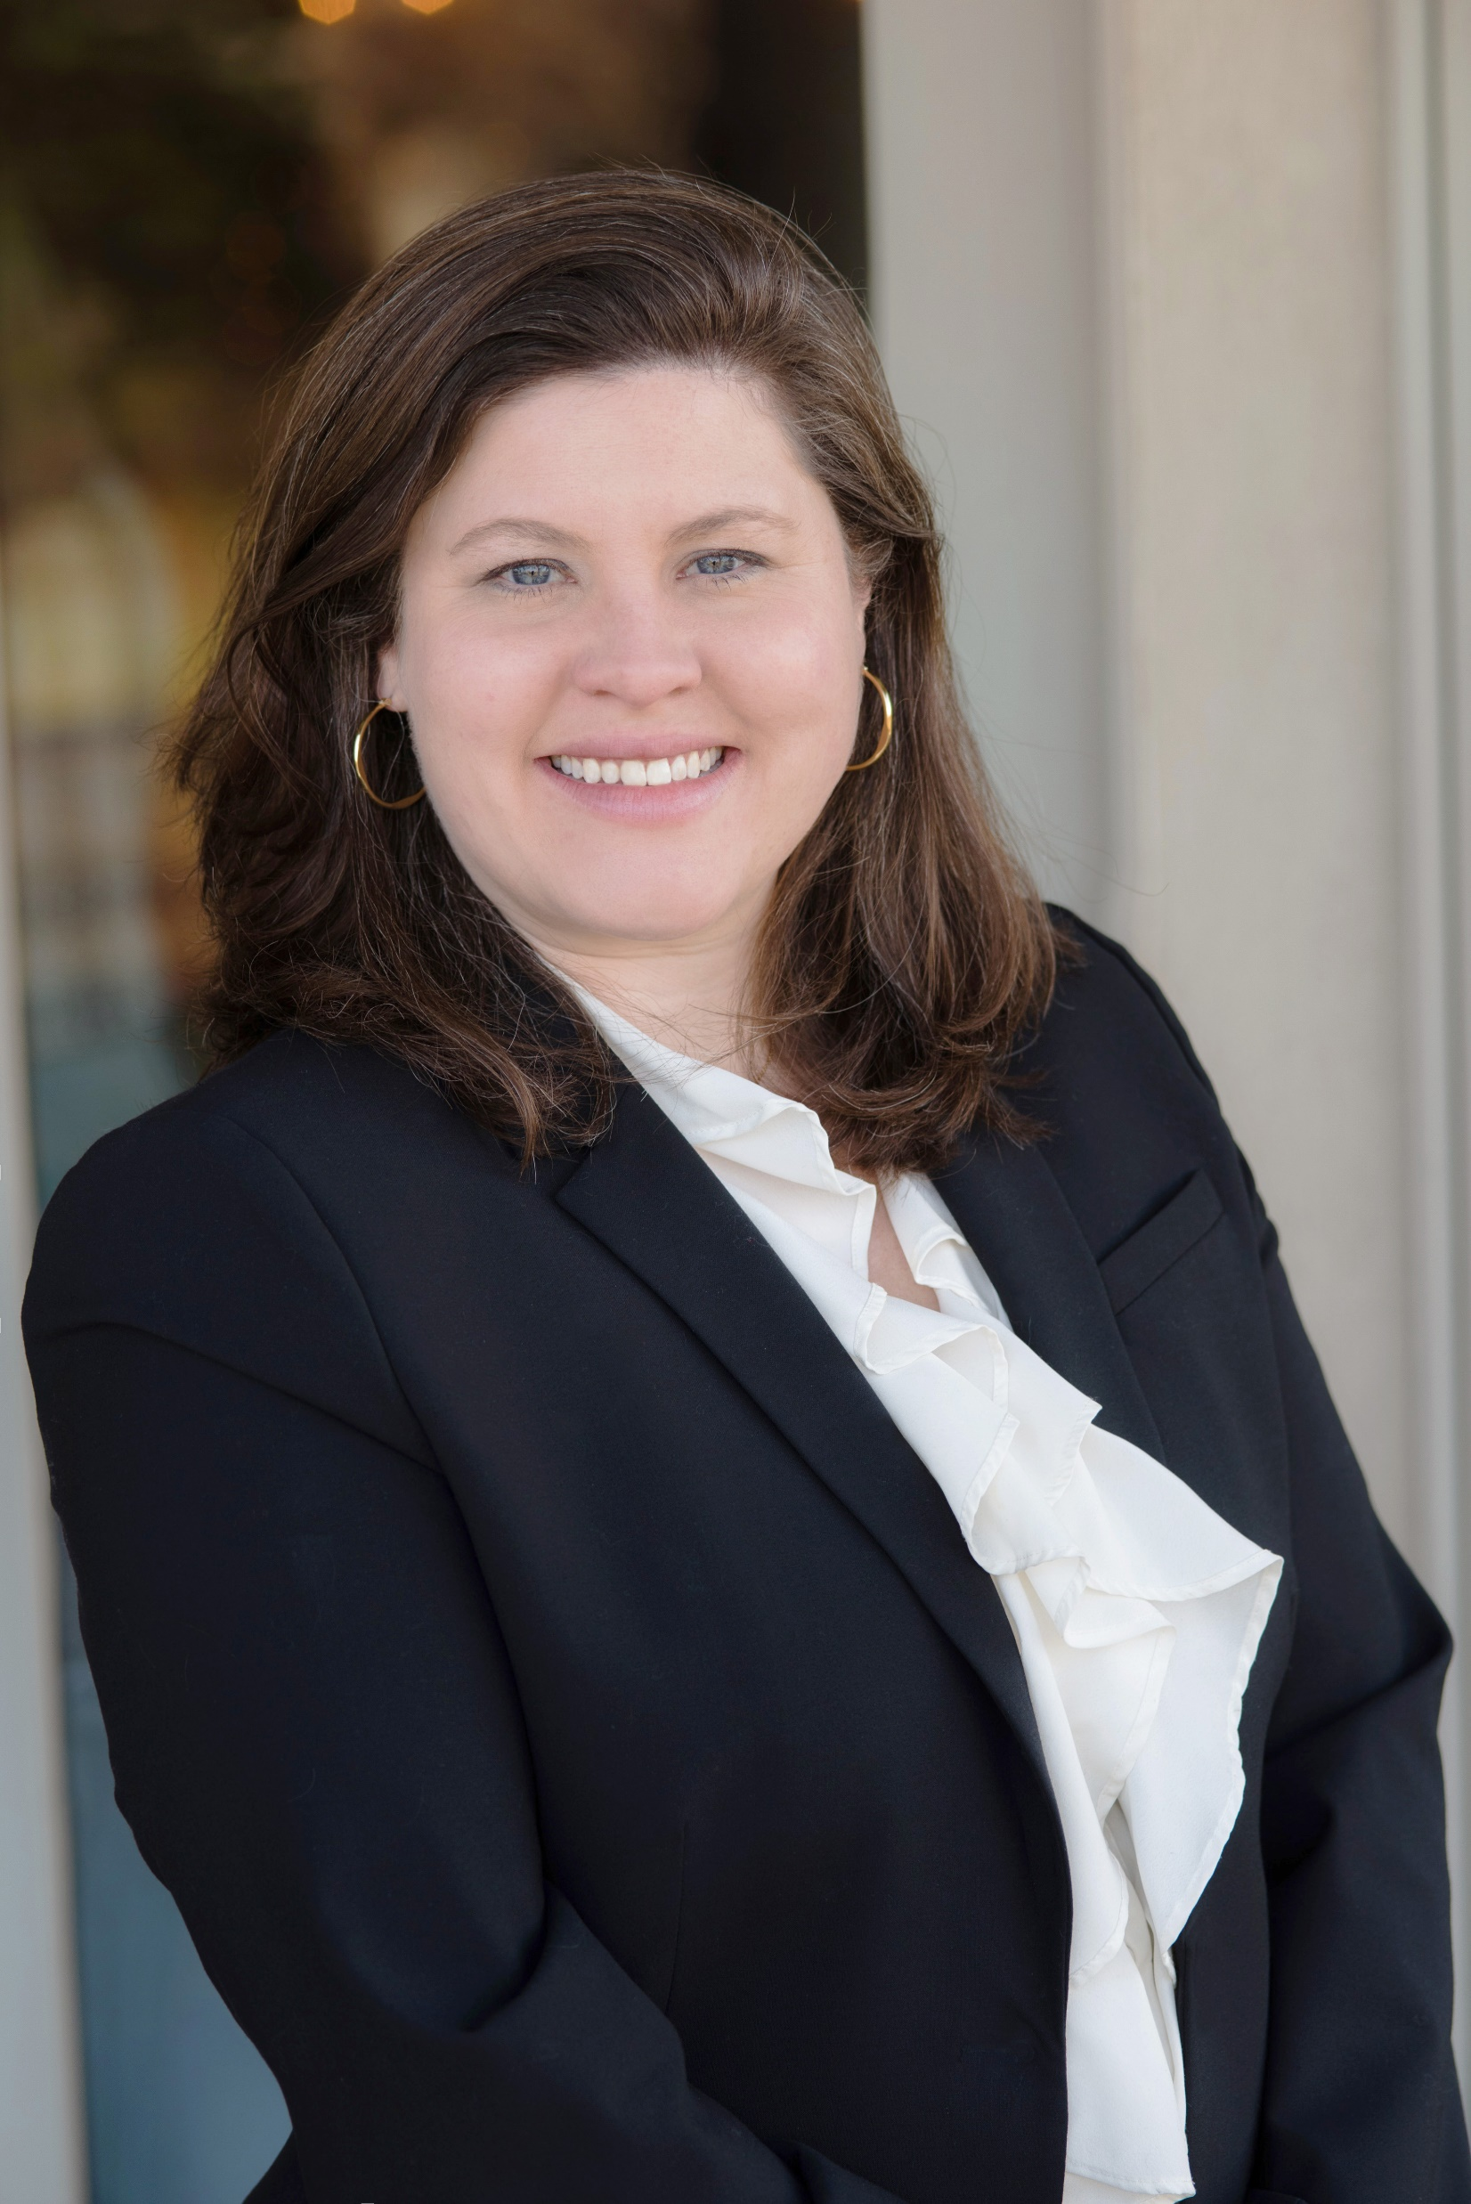

Faced with dashcam footage showing a chain rear-end crash in heavy rain, as well as photos of significant property damage, and conflicting testimony between surgeons, Alexandra Venters successfully defended a matter in Bucks County. The Jury ultimately found that the accident did not cause the alleged spinal fractures, among other injuries, nor was it the cause of hefty liens and or future medical costs of $111,000+ for injections, therapy and surgery.
Finishing the year with a win

