Slide 1

N248MA
Overview

Slide 2
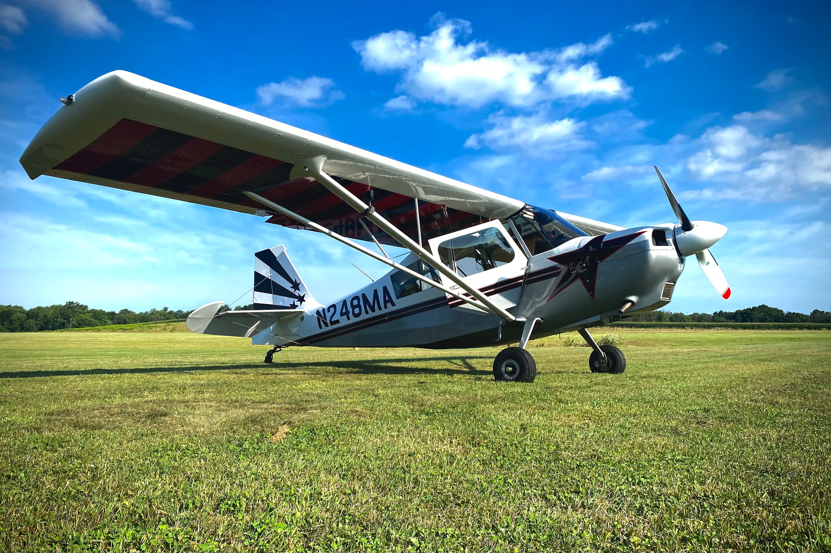
American Champion 8KCAB
AEIO 360 - 180 HP
Constant Speed Prop
Stalls - 53 mph
+6 to -5 Max G Limit
2 Minutes Inverted Flight

Slide 3
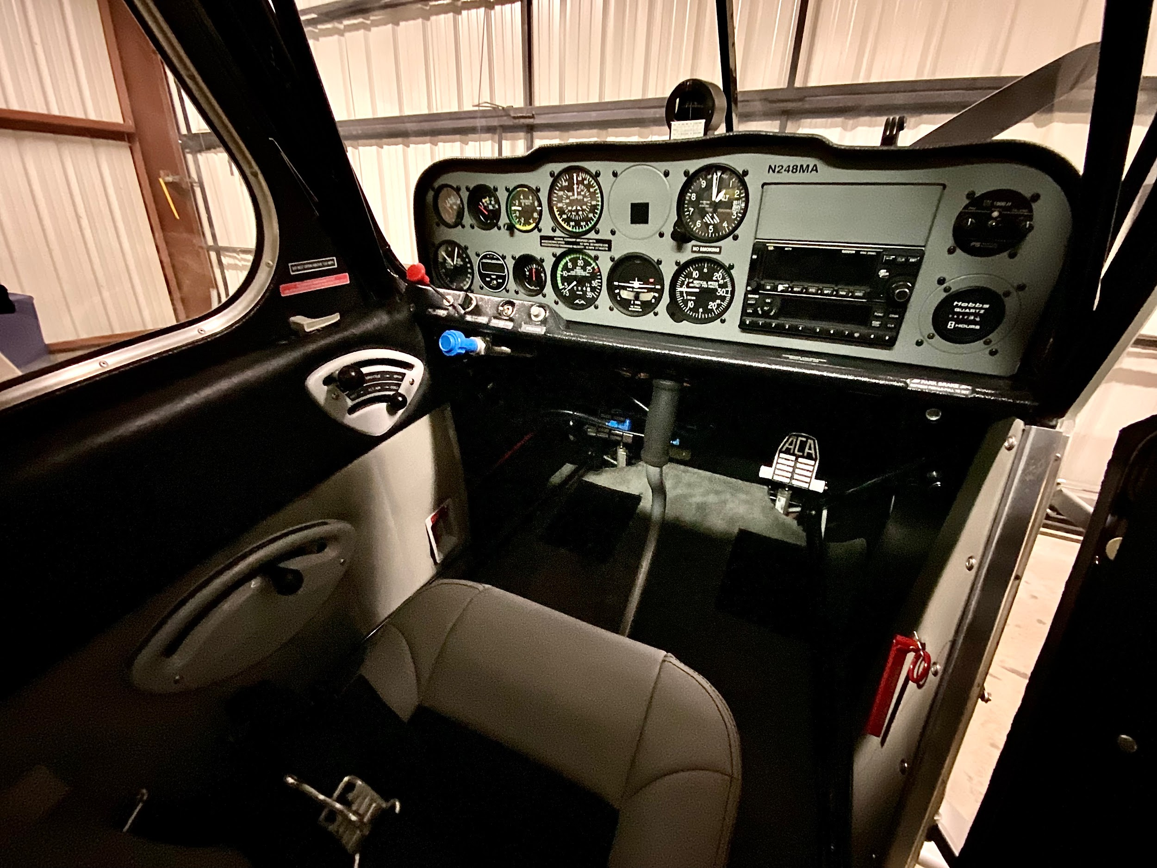

Slide 4
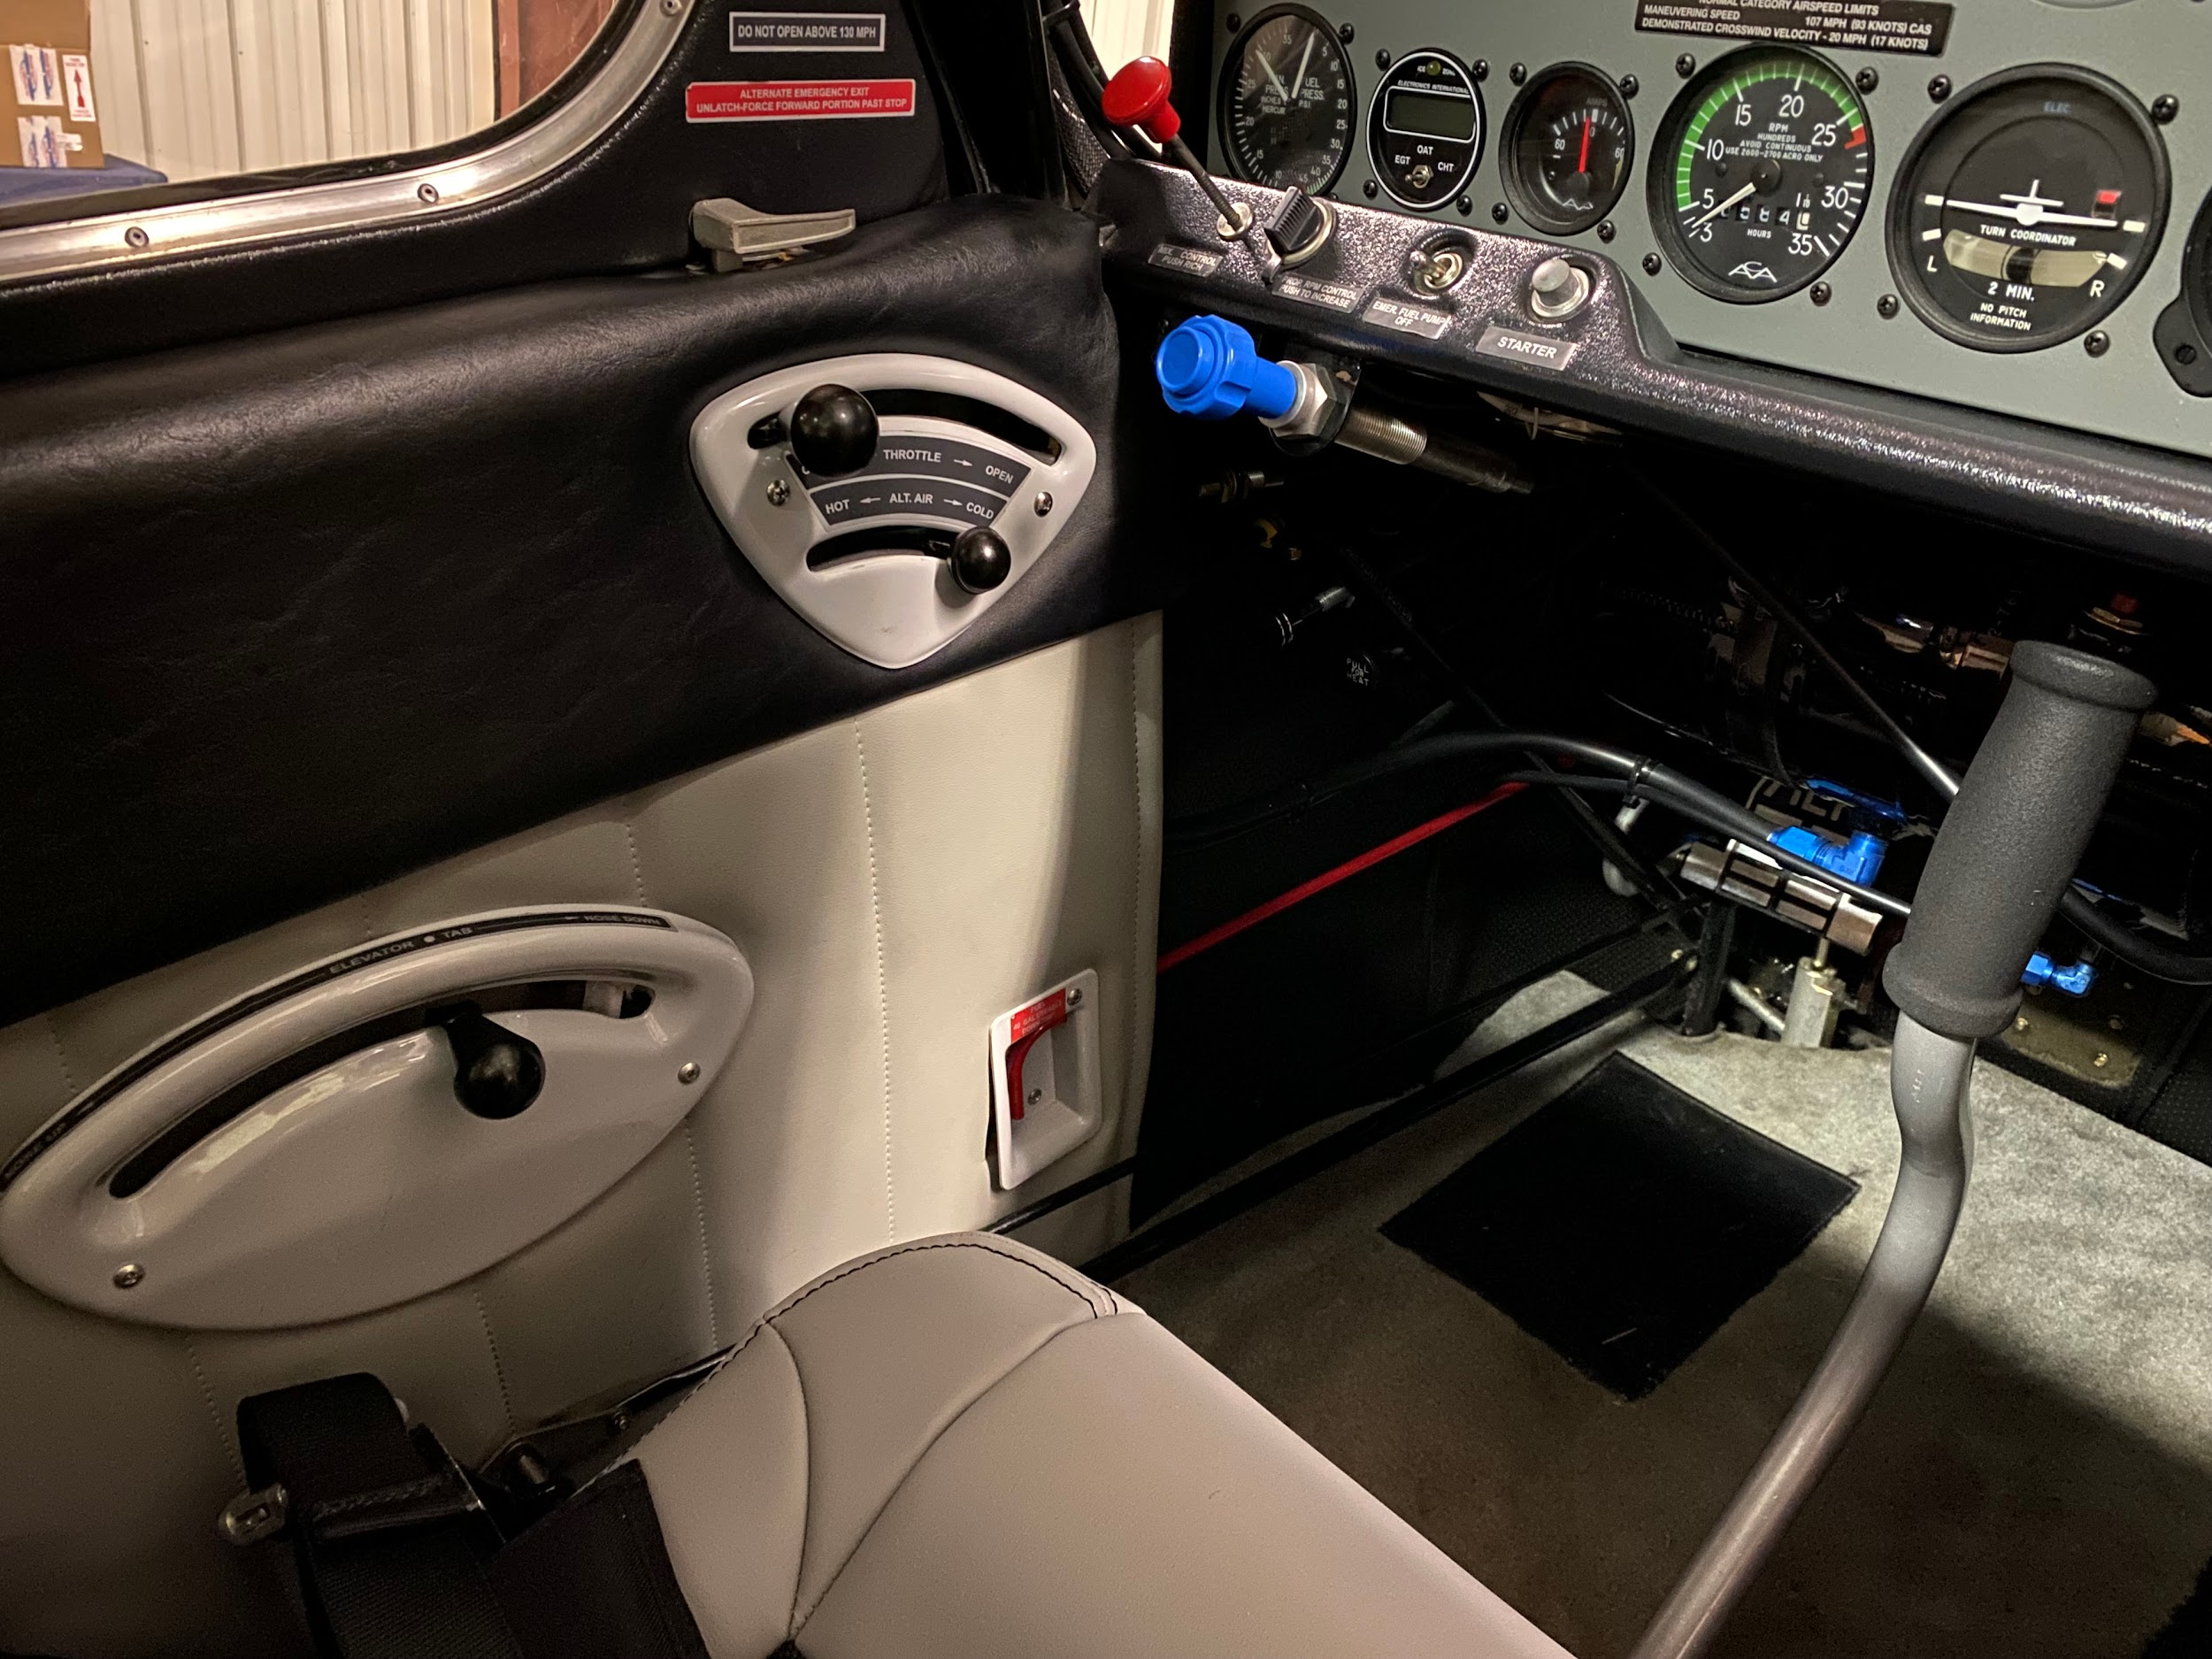

Slide 5
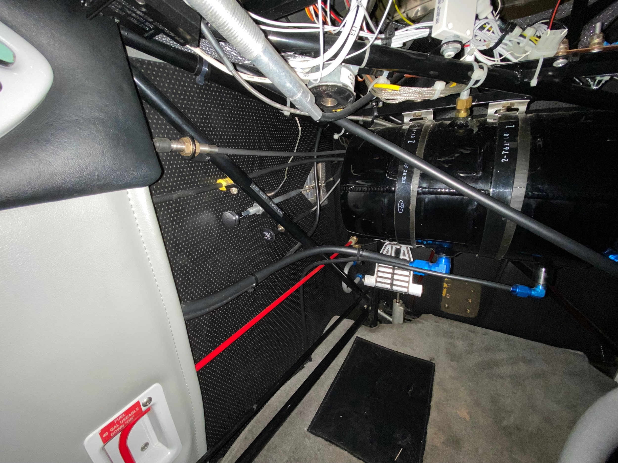
Heat and Air Vent Controls

Slide 6
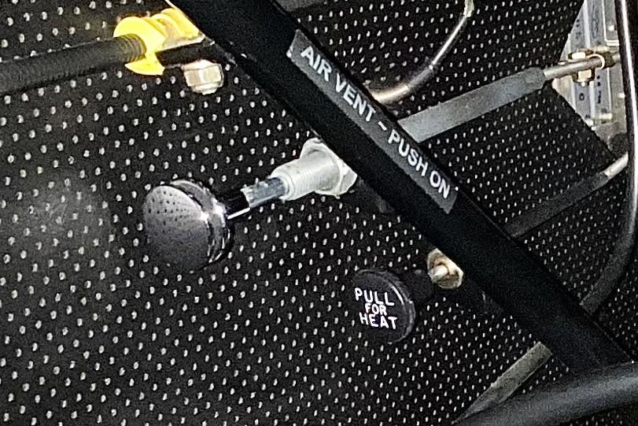

Slide 7
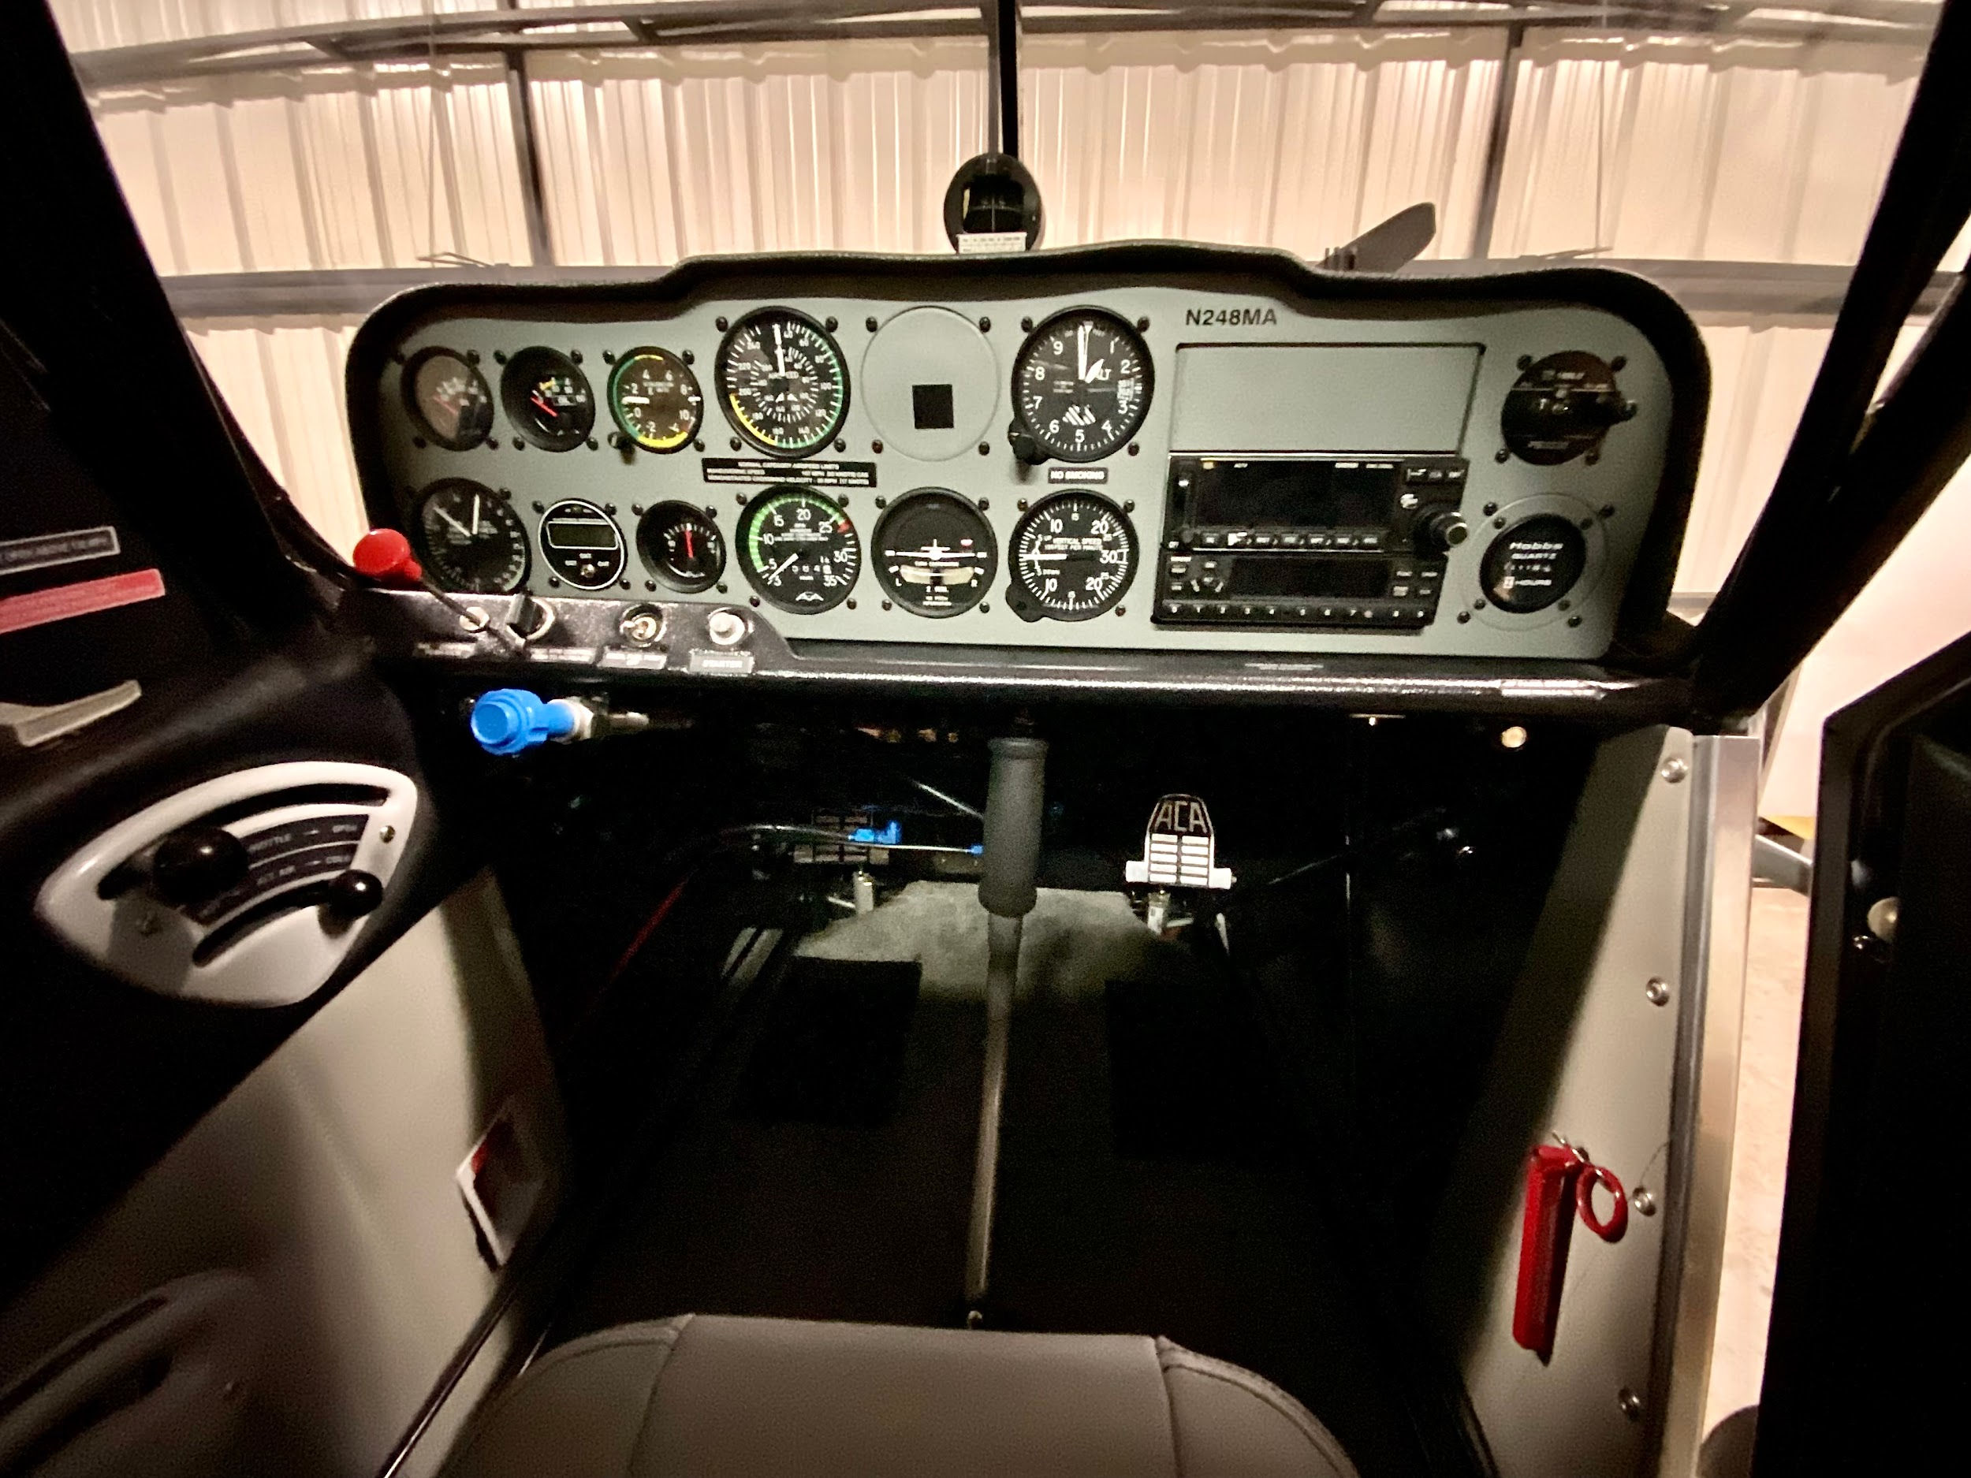

Slide 8
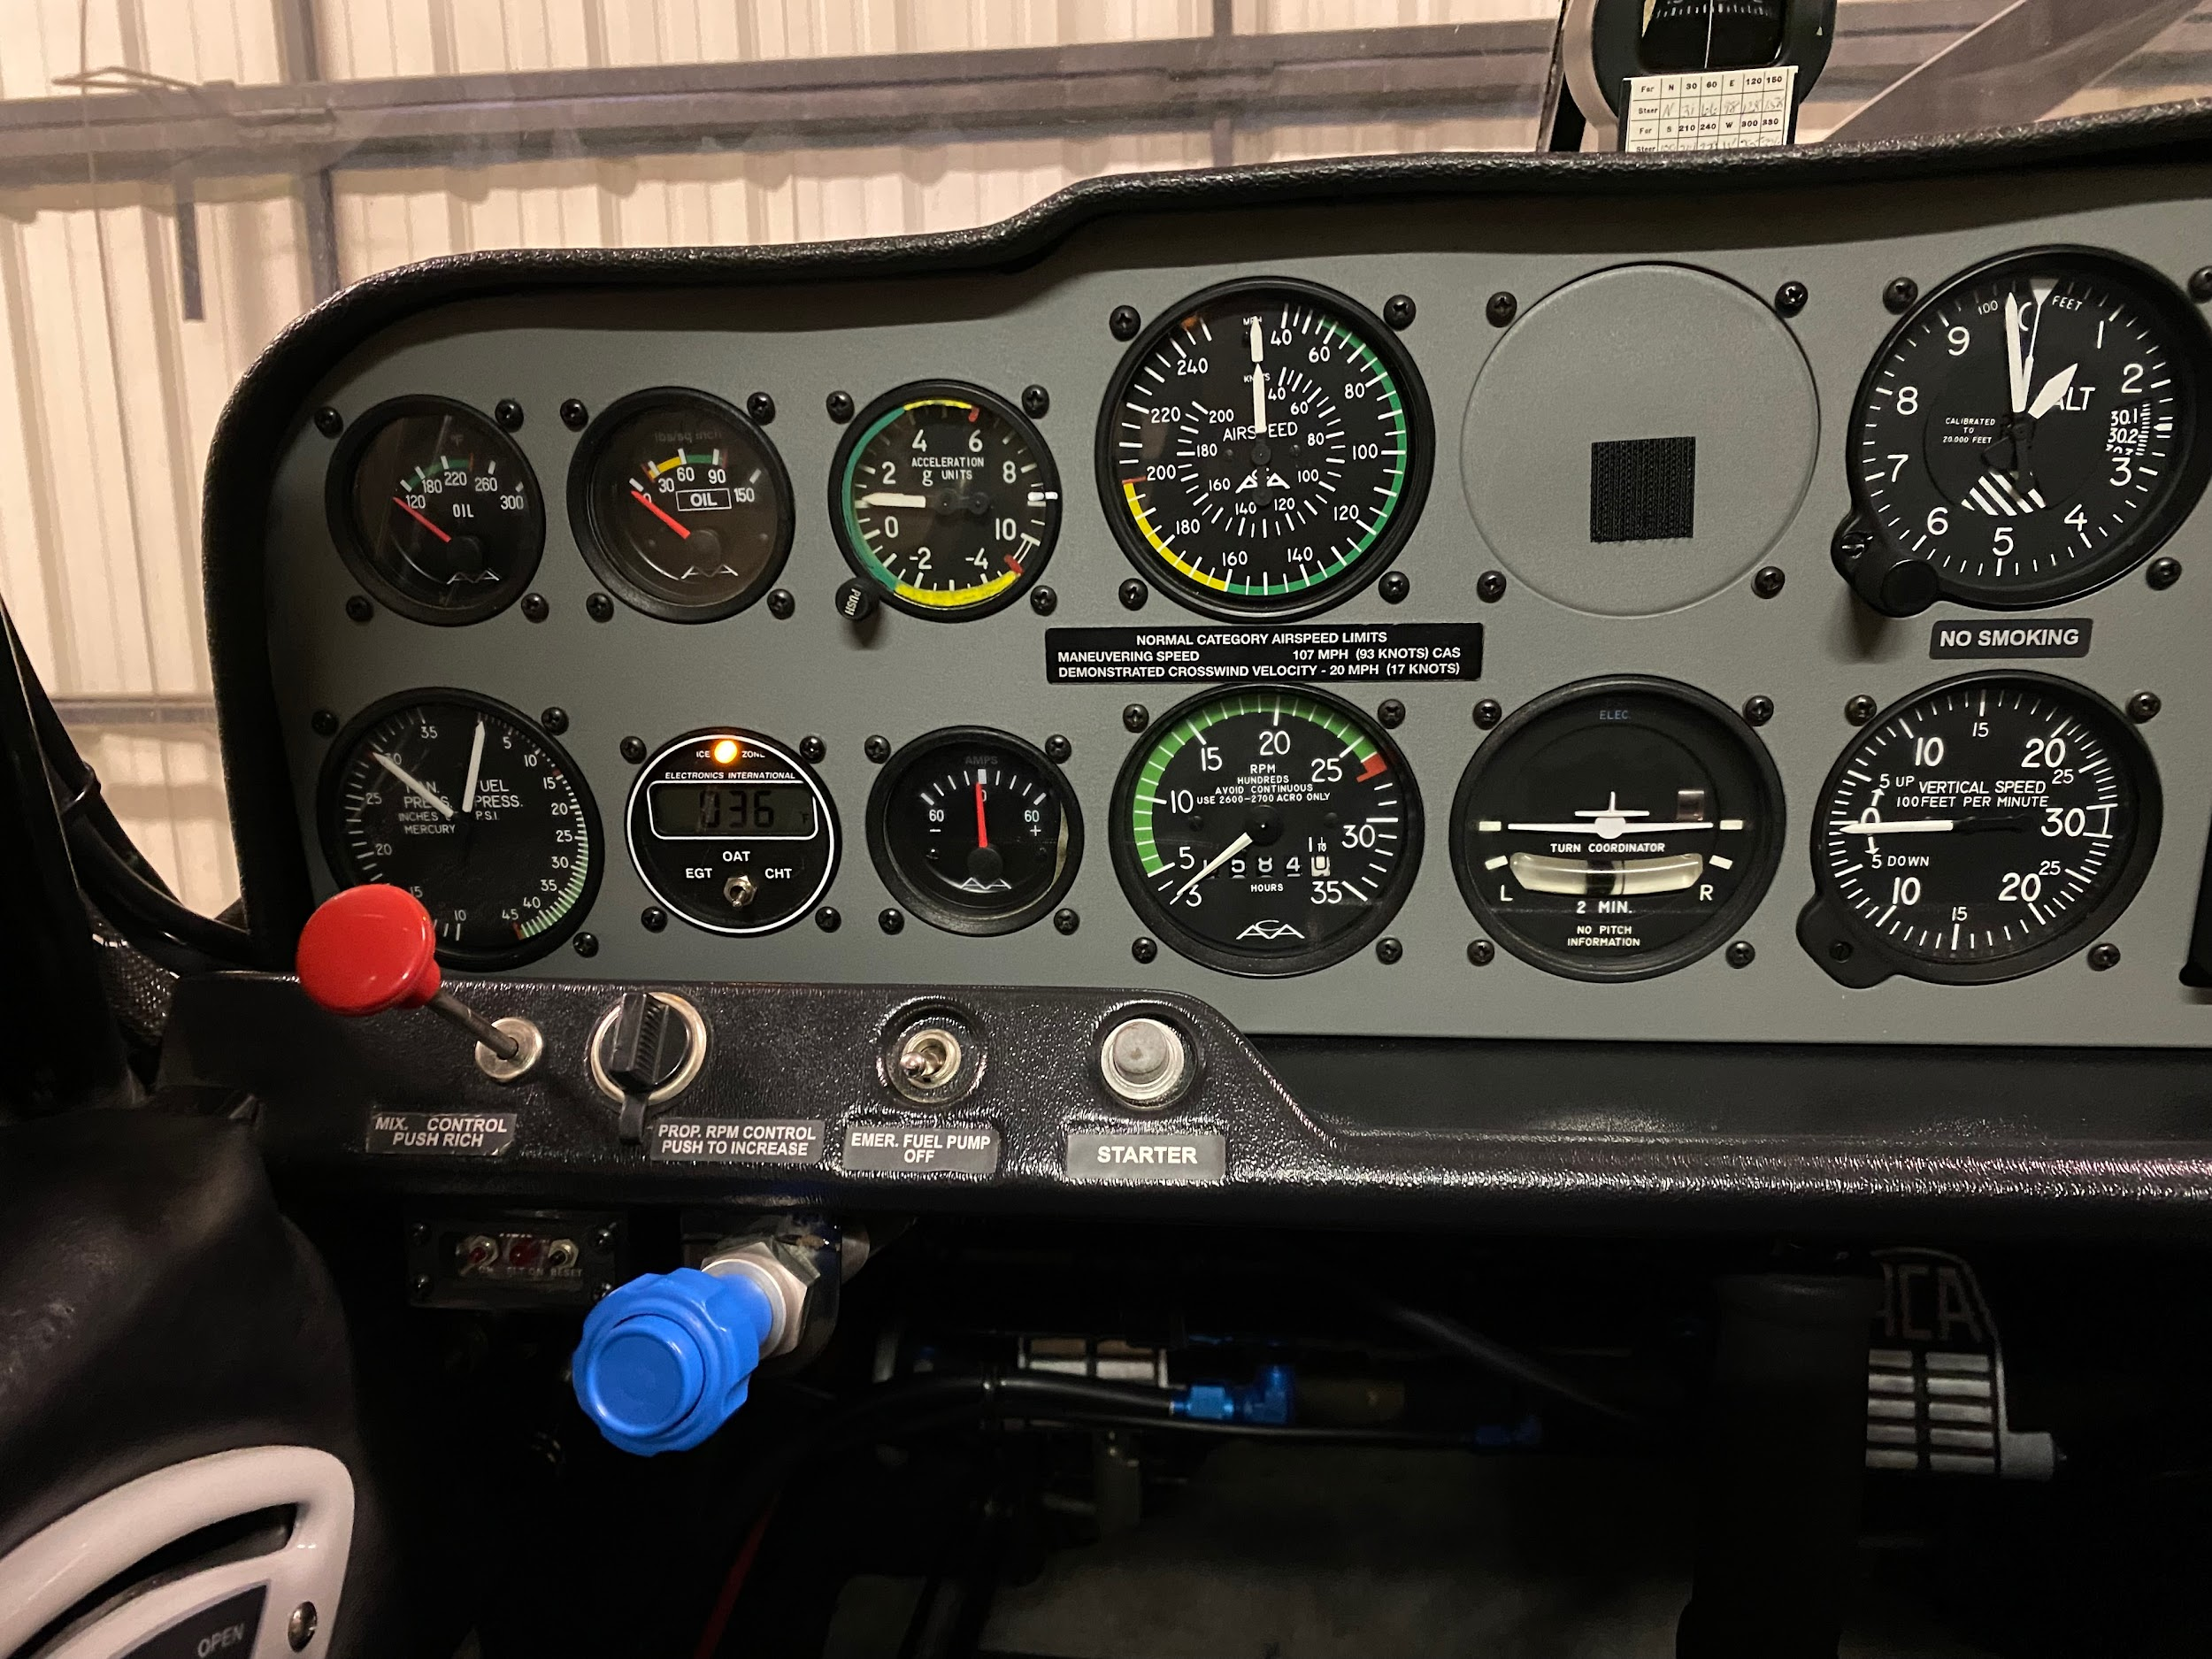

Slide 9
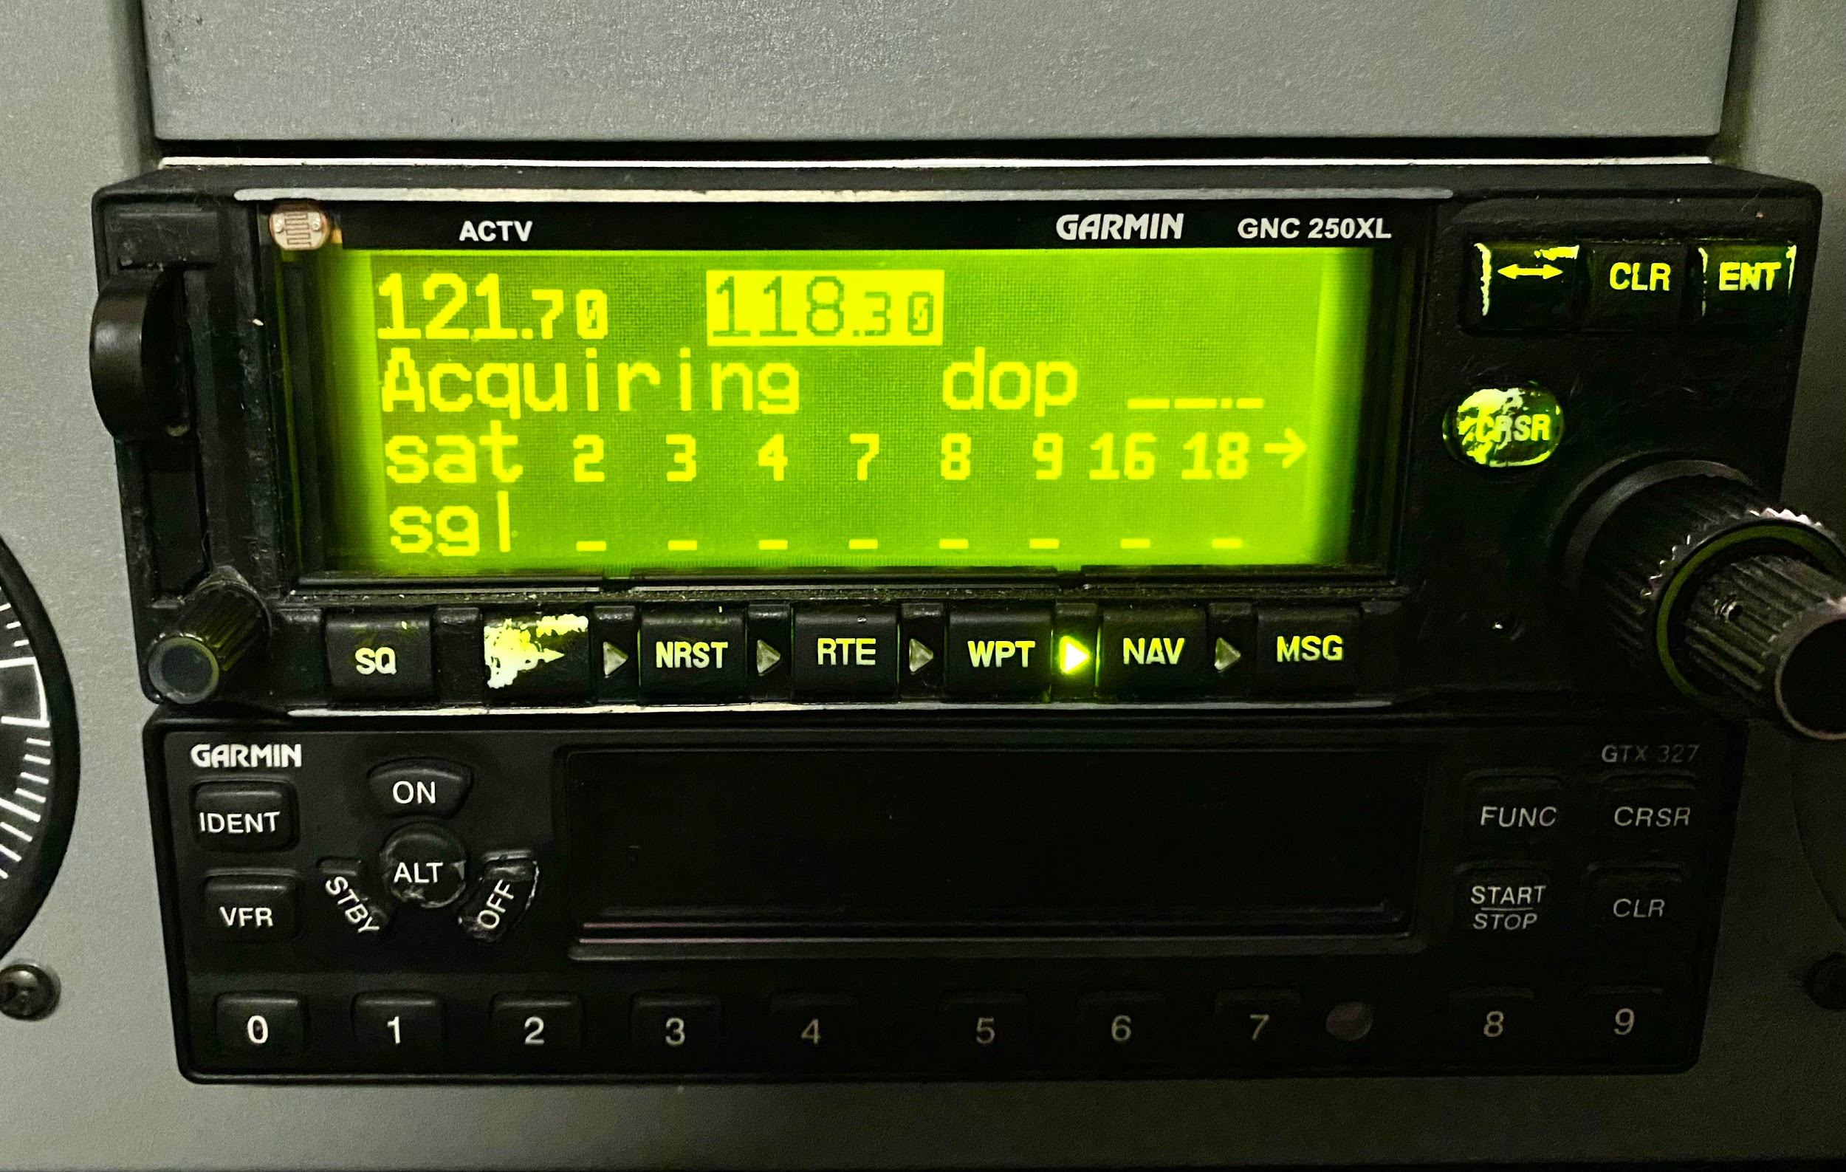

Slide 10
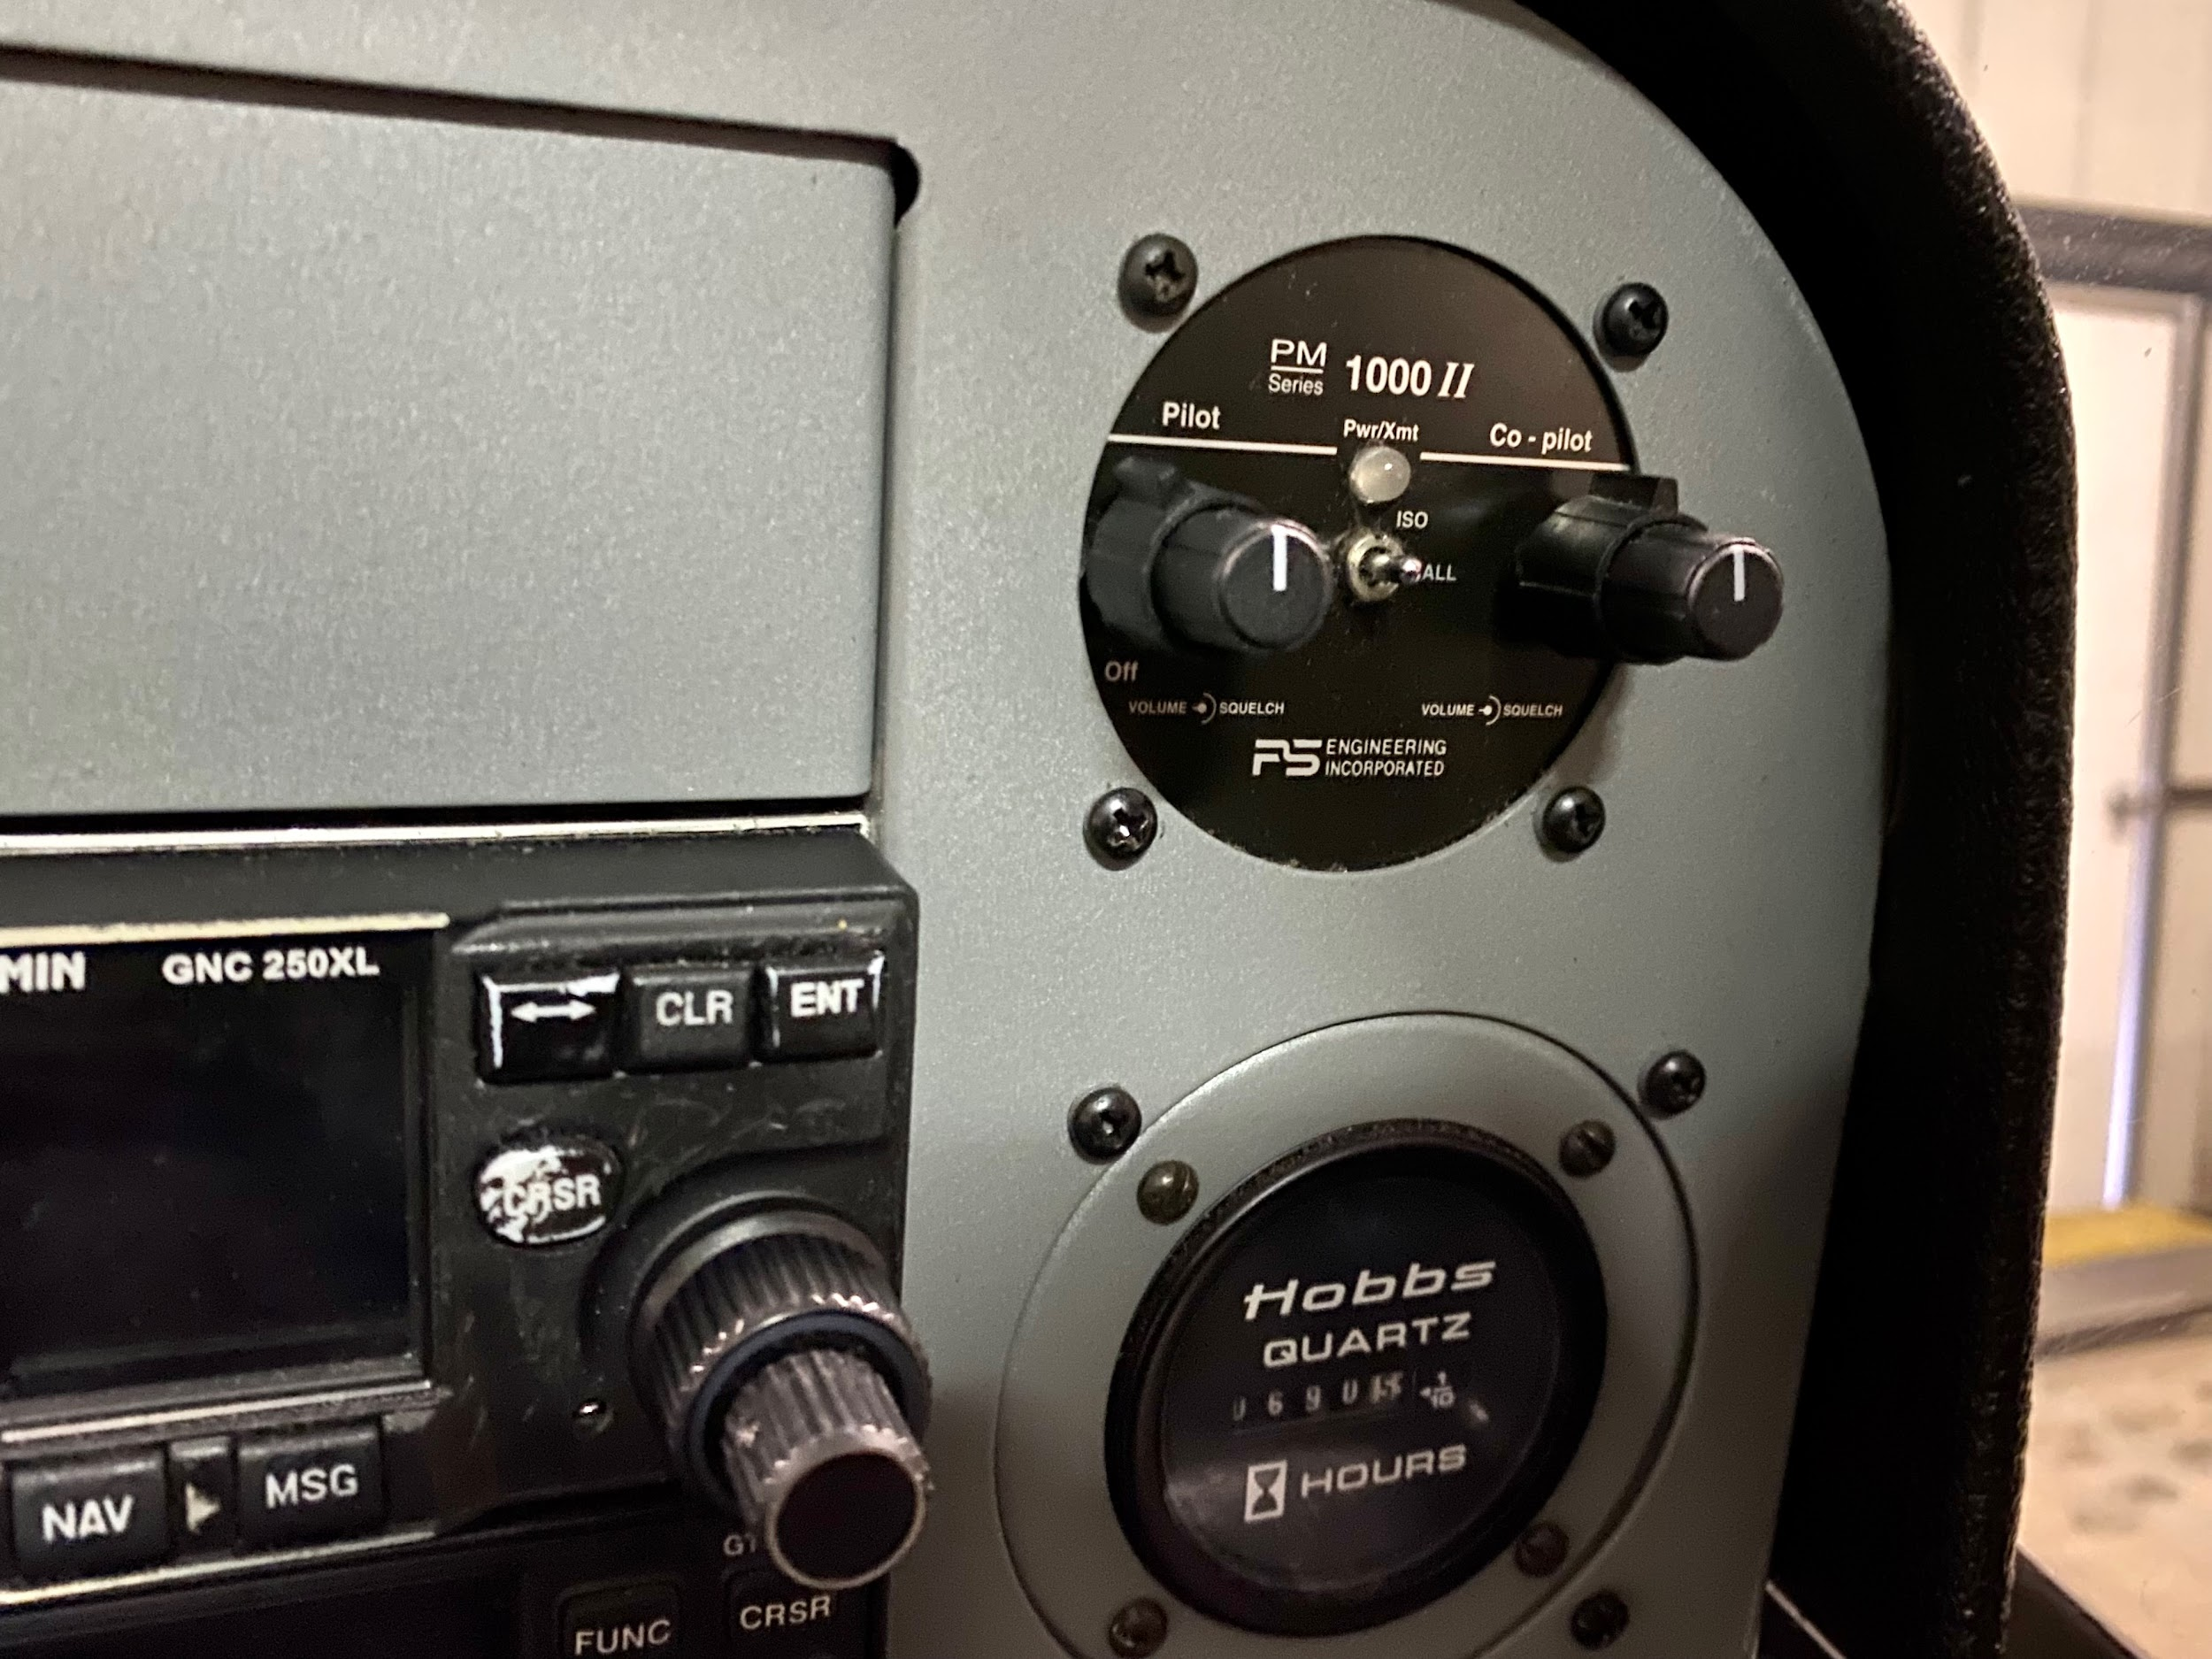

Slide 11
